Slide 1
Are the demand conditions in your industry favorable?

Slide 2
Objectives
Examine demand conditions in the context of entrepreneurial industry conditions
Explore the impact of demand conditions on success as an entrepreneur

Slide 3
Exploring industry conditions
Provides insights into the attractiveness of an industry for new entrants
Knowledge conditions
Demand conditions
With this understanding, aspiring entrepreneurs can determine if, and how, to compete effectively within their chosen industry

Slide 4
The Opportunity Analysis CanvasTM
Industry
Condition
Knowledge conditions
Demand
conditions
Entrepreneurial Motivation
Competition
Entrepreneurial Mindset
Industry
Status
Opportunity Identification
Entrepreneurial Behavior
Value
Curve
Macroeconomic
Change

Slide 5
Defining demand conditions
“the size, rate of growth, and
consistency of the market”
To create a successful new company, you need to introduce a product or service that:
satisfies customer needs in a better way than competitors; and
at a price that is greater than the cost of creating and delivering that product or service.

Slide 6
“A problem well-stated is a problem half-solved”
Seek new ways to solve a known problem rather than speculate on unknown problems
Study current products and customers to see needs and wants
For a real need to exist, the new product or service must be significantly better than alternatives
Entrepreneurs should develop and deliver exceptionally better value to customers

Slide 13
Researching demand conditions
IBISWorld
Industry Market Research and Industry Risk Ratings
BizStats
Business financial ratios and statistics
Eurostat
Statistics on the European Union countries
SBDCNet
National Information Clearinghouse of the U.S. Small Business Administration
U.S. Census Bureau
Economic indicators on monthly and quarterly bases, and economic census data every five year for every industry

Slide 14
To capitalize on demand conditions, focus on three aspects
Magnitude of customer demand for products and services, as this quantifies your number of prospective customers
Rate of growth of that demand, in that you should enter a growing market
Consistency of that demand across customer segments.

Slide 16
Seek a sizeable, growing market with a similar set of needs and wants
Segment your market into smaller sub-groups based on needs and wants, location, demographics, etc.
Valuable to prioritizing your resources and aligning your focus.
How can you, as the entrepreneur, carve out a niche that is sizeable enough to reach your goals, yet small enough to be unattractive to large companies?

Slide 17
Segmentation is an opportunity for entrepreneurs to specialize
Build your reputation and brand for doing one thing well
Leverage that into new segments later in your venture’s lifetime

Slide 18
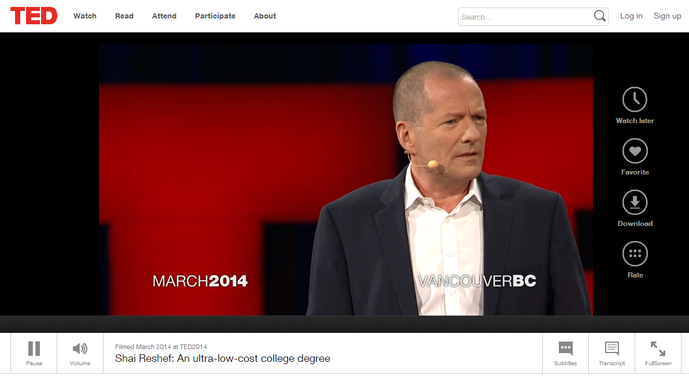

Slide 19
Summary
Is the industry that I am planning to enter a good one for starting a new company?
Are the demand conditions in the industry favorable to a start-up?
Magnitude of customer demand sufficiently high
Rate of growth increasing
Consistency of demand relatively homogenous

