Slide 1
Is the industry advertising intensive?

Slide 2
Objectives
Examine industry structure, with a focus on advertising intensity, in the context of entrepreneurial industry status
Explore the impact of advertising intensity on your success as an entrepreneur

Slide 3
Exploring industry structure
With industry conditions framing knowledge and demand factors, it’s important to understand industry status
Industry status addresses industry lifecycle and industry structure with an emphasis on growth opportunities and industry evolution
By studying industry structure, aspiring entrepreneurs can assess the industry’s timeliness for new entrepreneurial entrants

Slide 4
The Opportunity Analysis CanvasTM
Industry
Condition
Entrepreneurial Motivation
Competition
Entrepreneurial Mindset
Industry
Status
Industry lifecycle
Industry structure
Opportunity Identification
Entrepreneurial Behavior
Value
Curve
Macroeconomic
Change

Slide 5
Defining advertising intensity
“importance of advertising and branding to the success of competitors
in a specific industry”
Capital intensity
Advertising intensity
Company concentration
Average company size

Slide 6
High advertising intensity industries
Customers prefer to buy from companies
Based on past successful transactions
Offering of preferred products or brands
Established companies may have a reputation for success
New ventures find it harder to attract customers
Perks
Loyalty program rewards

Slide 7
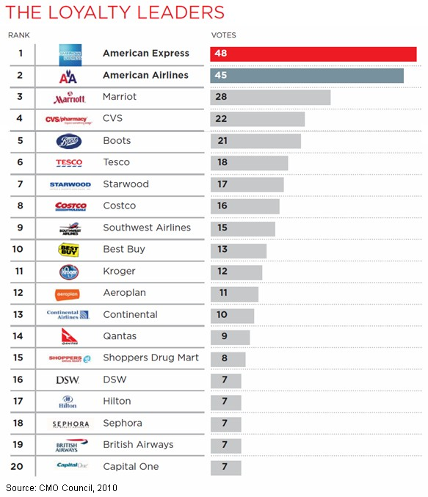

Slide 8
Low advertising intensity industries
Customers are open to trying new products
Willingness of customers to buy new brands
Influences may includes
No established product leaders
Low switching costs
Differentiation and/or value of new venture
This is the preferred scenario for new ventures

Slide 15
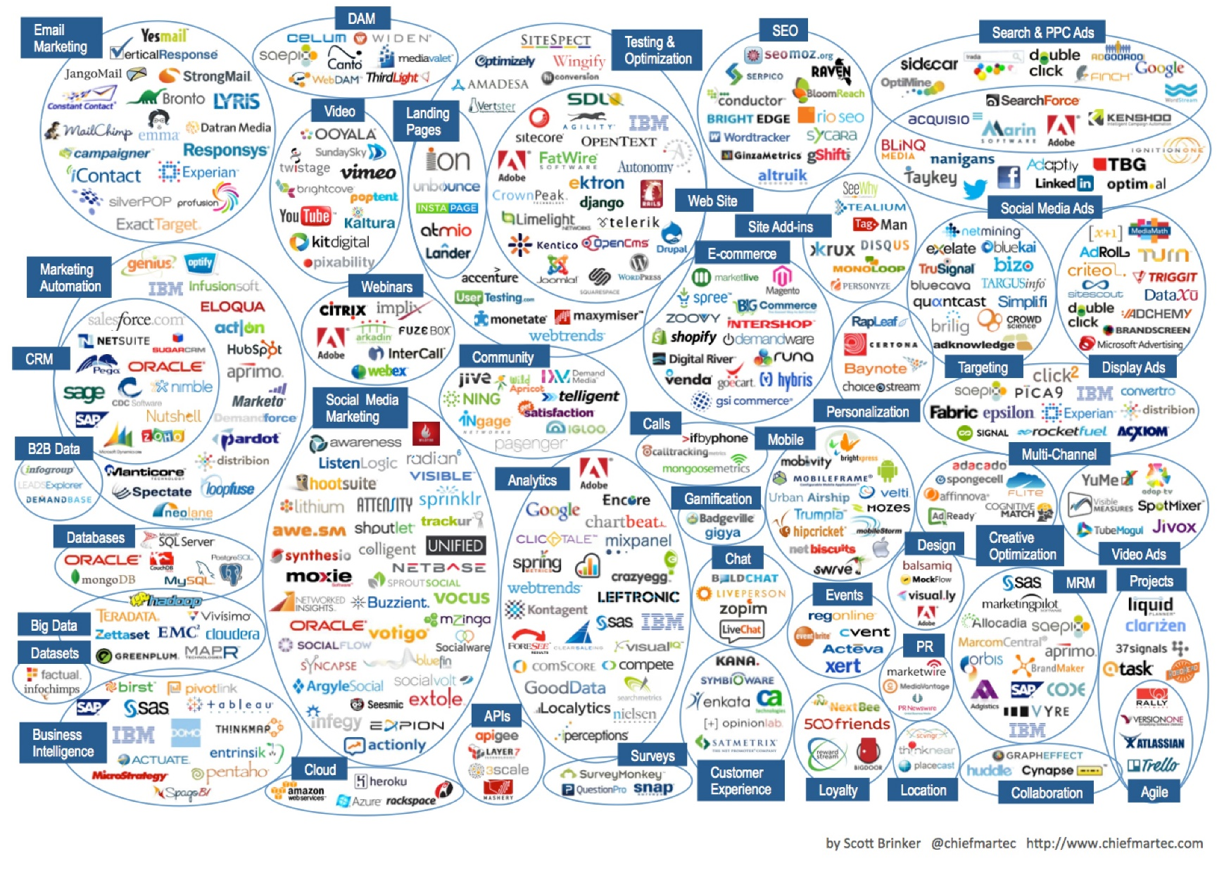

Slide 17
Summary
By studying industry structure, aspiring entrepreneurs can assess the industry’s timeliness for new entrepreneurial entrants
And better understand how to compete
Low advertising intensity presents a more affordable opportunity for new entrants to enter and compete effectively
Also suggests that brand loyalty of incumbents is more surmountable by new entrants

