Slide 1
What new factors can you create?

Slide 2
Objectives
Explore value innovation as an approach to entrepreneurial opportunity analysis and new venture creation
Explore the impact of creating factors on your success as an entrepreneur

Slide 3
The Opportunity Analysis CanvasTM
Industry
Condition
Entrepreneurial Motivation
Competition
Entrepreneurial Mindset
Industry
Status
Opportunity Identification
Entrepreneurial Behavior
Value
Curve
Eliminate
Reduce
Raise
Create
Macroeconomic
Change

Slide 4
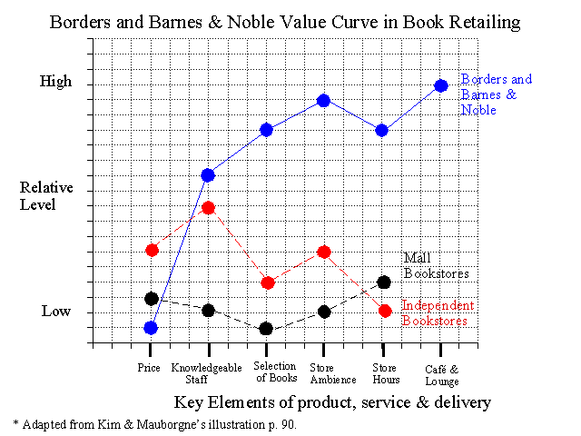
Value Innovation
(Kim & Mauborgne, 1997)

Slide 5
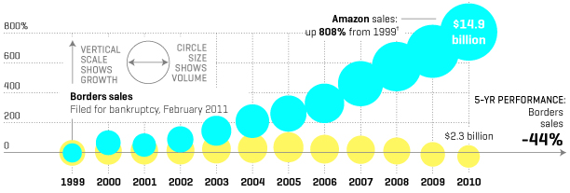
Be thoughtful in selecting the key features for your value curve
cnn.com

Slide 6
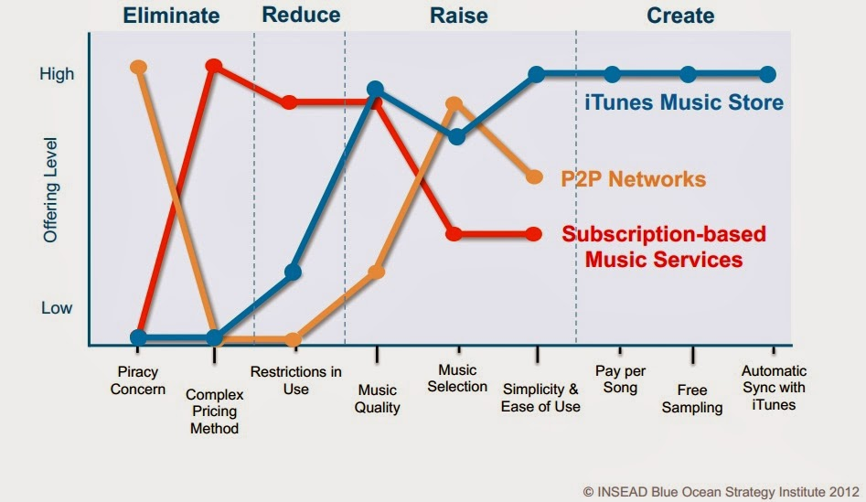

Slide 8
Summary
Are there opportunities to create new factors that will satisfy customers in new ways?
And make the competition less relevant
If entirely new features or benefits can be delivered by your product or service:
You are unique in this way
You are highly valuable to customers
You are a viable competitor in the market

