Slide 1
Where can you reduce factors and not reduce value?

Slide 2
Objectives
Explore value innovation as an approach to entrepreneurial opportunity analysis and new venture creation
Explore the impact of reducing factors on your success as an entrepreneur

Slide 3
The Opportunity Analysis CanvasTM
Industry
Condition
Entrepreneurial Motivation
Competition
Entrepreneurial Mindset
Industry
Status
Opportunity Identification
Entrepreneurial Behavior
Value
Innovation
Eliminate
Reduce
Raise
Create
Macroeconomic
Change

Slide 4
While select factors may be eliminated, others may be preserved, albeit reduced
Presents an opportunity to be more efficient and effective than competitors
Deprioritizing less essential factors enables you to focus on the high value factors

Slide 5
Nintendo Wii
Envisioned a new interactive game play format
Abandoned the conventional keypad controller
Embraced a new motion-based approach
Active play
Pulled kids off of the sofa
Enticed adults as well

Slide 6
http://www.mediacrayon.com/kids

Slide 7
Nintendo’s unconventional thinking
Abandoned traditional emphasis of
Better graphics,
Faster computing power, and
Complex game strategies and storylines
Reduced selected factors and emphasized others to compete in a new way with
Sony’s PlayStation and
Microsoft’s X-box

Slide 8
Nintendo’s new customers
Create new customer demand by engaging customers previously unserved in a product category
For Nintendo, these noncustomers were
Older non-gamers,
Parents who desired their children to be more active, and
Very young children

Slide 9
Benefits of “simple”
Led to a console based on
Fun,
Simplicity, and
Interactivity
Reduced the need to invest in consoles that were
Expensive to build,
Expensive to sell, and
Expensive to develop games

Slide 10
Create new demand from new customers by focusing on new wants and needs
Understand that there are typically far more noncustomers than current customers
Look across existing boundaries of competition
Rethink buyer value to create a new market where a new type of demand can be developed
Effectively determine what to reduce, what to raise, and what to create.

Slide 11
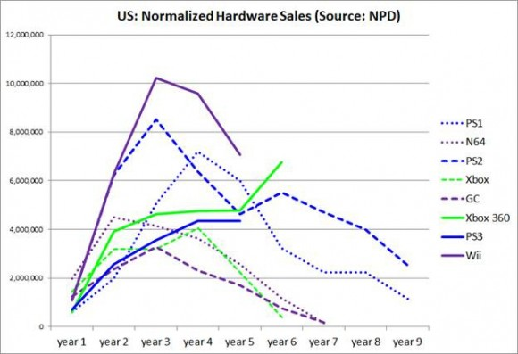

Slide 12
Summary
Reducing factors presents an opportunity to be more efficient and effective than competitors
Differentiate from competitors and reallocate resources to higher priority items
Step three of value innovation is raising factors

